Slide 1
Life Of Youth

Slide 2
Young people and youth motion in recent year steel by an important factor and in life . Numerous organizations were formed after the second world war, uniting the young people of all classes and layers of population. Some young people work in church organizations: help aged or work, and hospitals.

Slide 3
There is nothing more beautiful than nature ..I love everything connected with it: I love forests, flowers, air, earth, water, animals ...It pleases my eye - no buildings, no pictures no clothes - nothing that man has created, in my opinion, can not even compare to the beauty of nature ..:-)))))) Beautiful northern wilderness, with its lyutymi frosts and white, sparkling in the dark polar night, the snow, with its coniferous forests and swamps .

Slide 4
Spring

Slide 5
Nature-a small miracle, or rather, it is even greater miracle is a miracle, you will see someday how beautiful, how beautiful the tree through the branched crown of which you can see the sun as it plays its rays of the skin, it caresses you, and how beautiful bushes in the park? They are also superb, they are small, but they are beautiful. And the clouds floating over us? It's also little wonder, just what patterns there will not see. A starry sky? But the earth.."

Slide 6
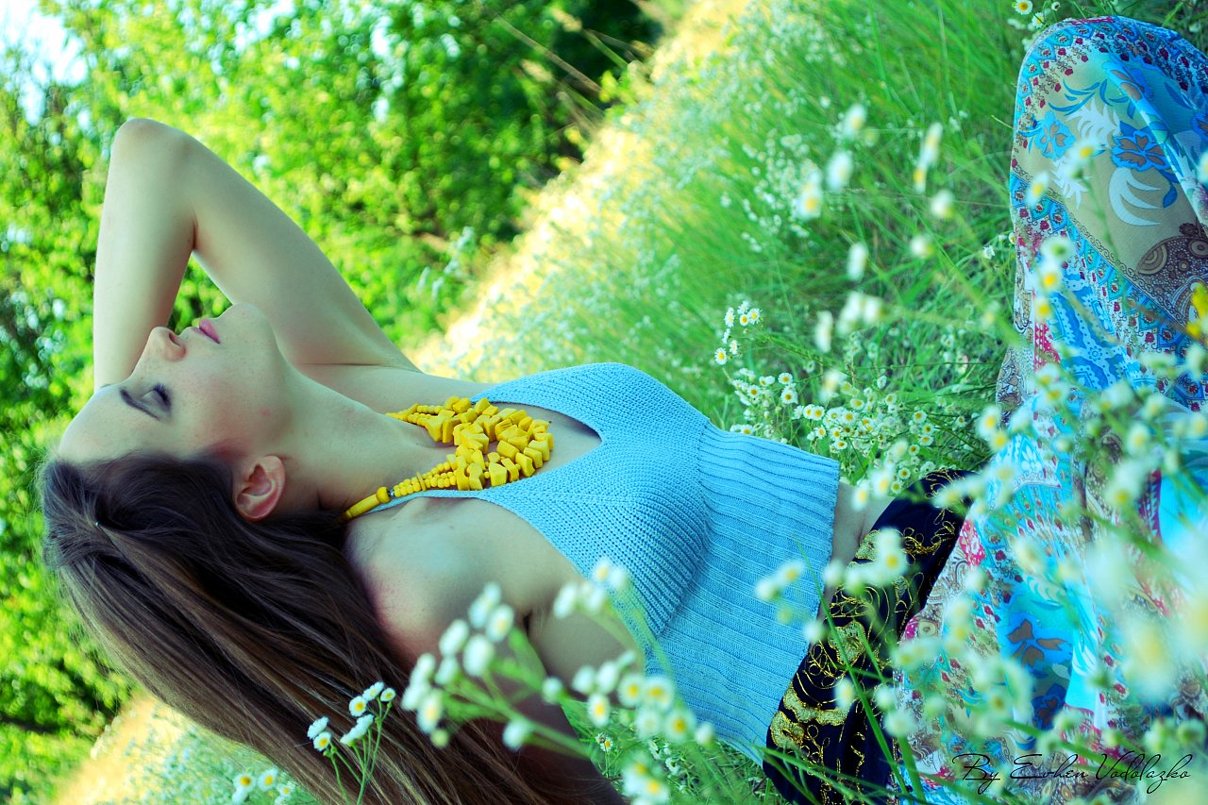
Beautiful southern nature, with its colorful trees and flowers, when the fragrance of flowers and lush greenery is in the air ... not less beautiful nature of the middle band: a modest, quiet pleasing me, then rainy weather, the joyous sun .. . There is no bad weather

Slide 7
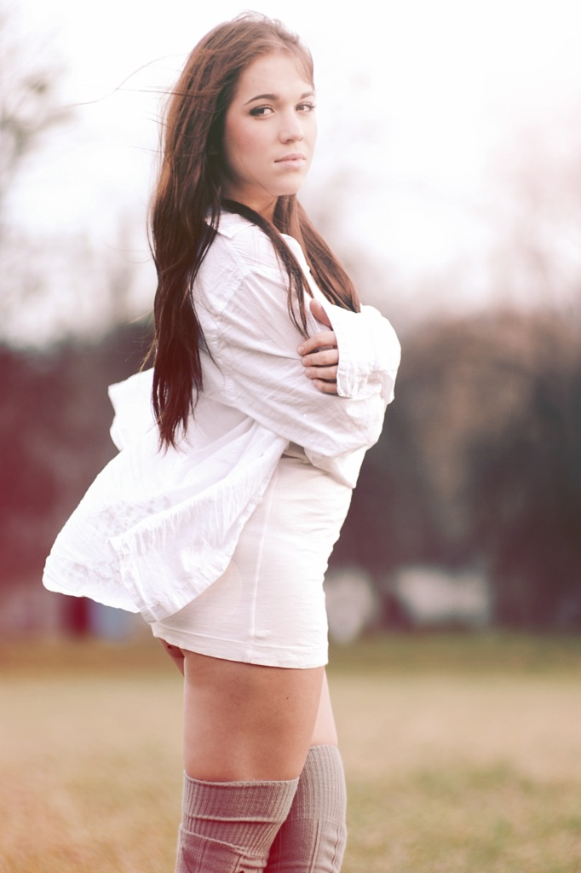

Slide 8
The more deeply immersed in nature, the more convinced of the certainty of life. It is only in appearance, wildlife fragile, but actually hid inside her much more powerful force capable to overcome not only millions of years, but milliard billion

Slide 9
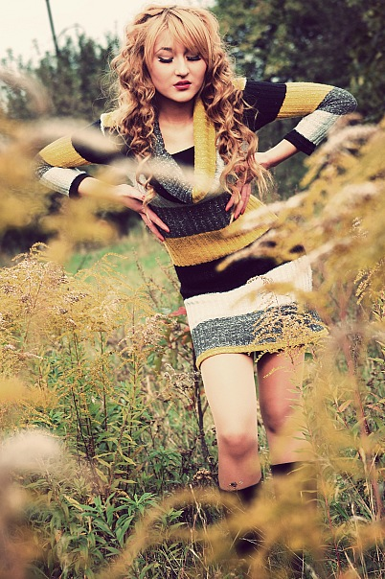

Slide 10
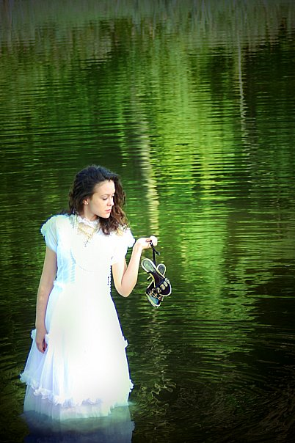

Slide 13
I - part of nature ... And I myself, oddly enough, I love ... Yes, every man - wonder of nature, and some people I very much sympathize with, even some very, very, some, I probably love in a sense ... And even more, I still love animals, trees, plants, water, snow, rain, wind, thunder and lightning, moon, stars ... Much of the created nature ... Nature would be great done without us, the people, while we are without it would cost ..Without people nature would only cleaner and more beautiful ... no matter how corny it sounds ... Undefiled human presence is majestic, wise and harmonious ... But on the other side: the people - the creation of nature - "everything created by human beings - are also part of nature -" everything that happens - the evolution to what she might maintain, even for self-destruction of mankind ... Perhaps it is right and natural, so it should be ... Nature is beautiful, it soothes, it adjusts to the desired mood. Mountains .. How do I love the mountains, they have something powerful, not a man under authority, power, some unseen force and calmness. A tall forest, which stretches for miles .. After the rain breathing coolness and freshness.

Slide 14
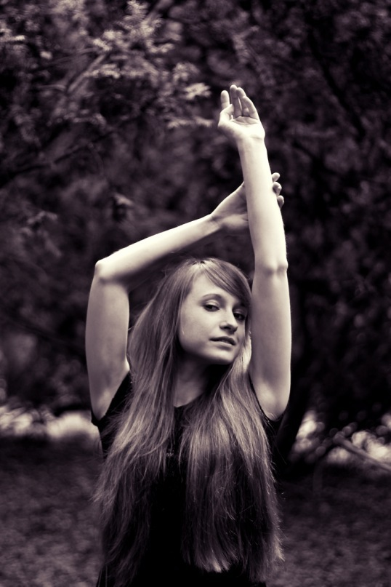

Slide 16
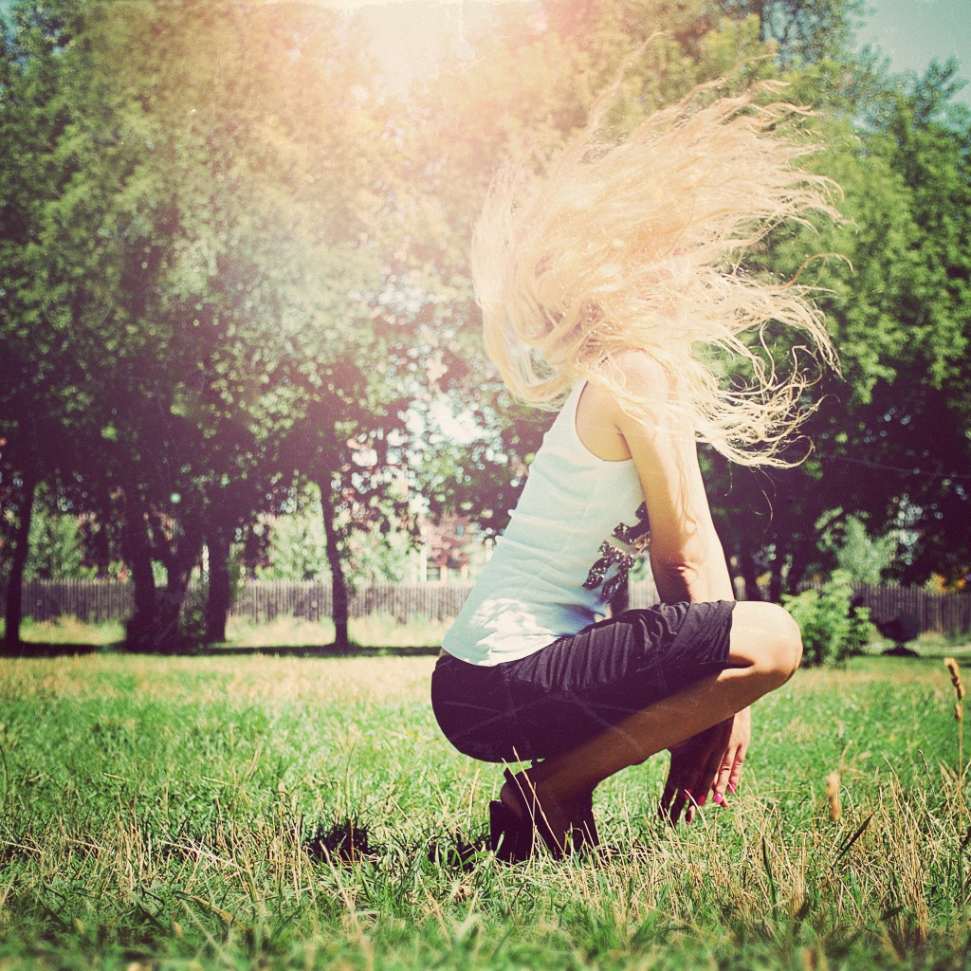

Slide 17
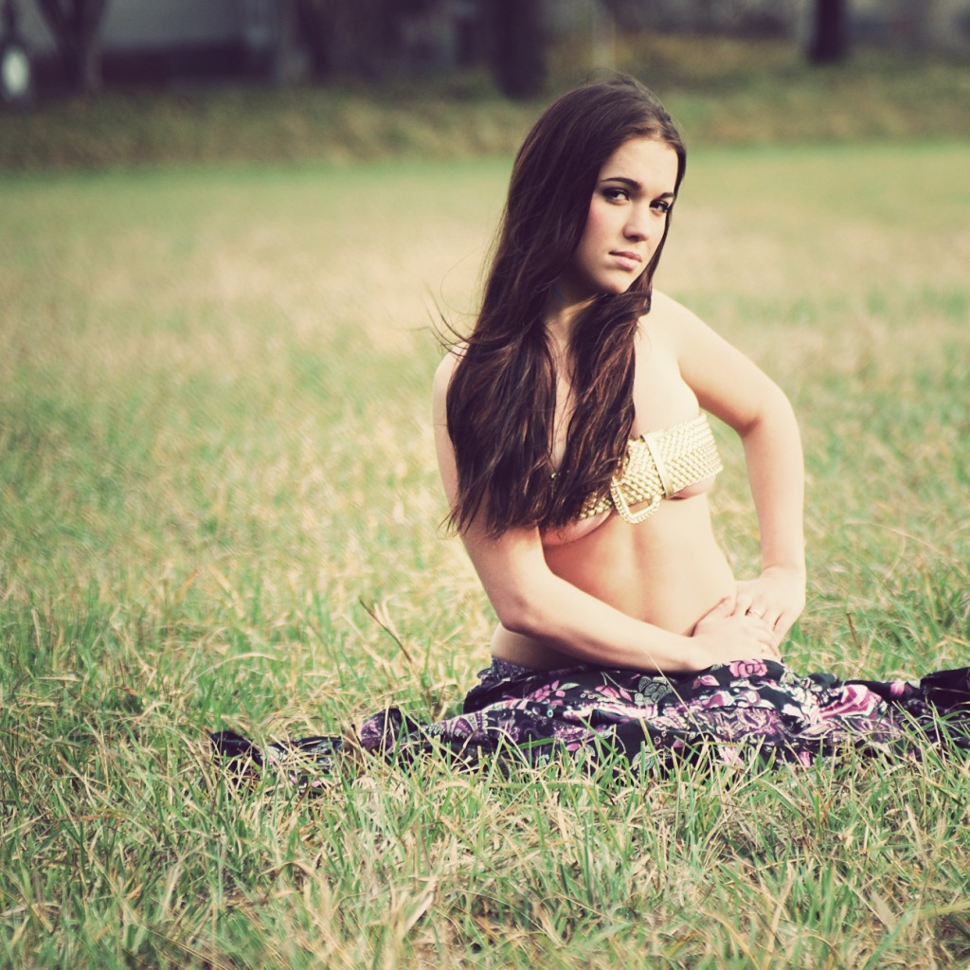

Slide 18
Nowadays when our independent state Ukraine is developing? Much attention is paid to our youth. The desire of our young people to become qualified specialists in future motivates them to enter higher educational establishments.

Slide 19
сс с

Slide 22
Student
years

Slide 23
That is why beside their studies they are also engaged in different clubs and organizations.
For young people higher education is the method of developing . Their talents and abilities, their creative potential .

Slide 26
студенты

Slide 28
hobby

Slide 32
Sports

Slide 37
go for a walk
at night

Slide 44
life is beautiful

Slide 57
my friends
the party and

Slide 60
Love

Slide 62
Love story

Slide 71
THE END
THE END

